Slide 1
We got your backend.

Slide 2
Good Evening
TECHNORI
Jordan Gilman
Founder & Architect, PeopleVine
jordan@peoplevine.com

Slide 3
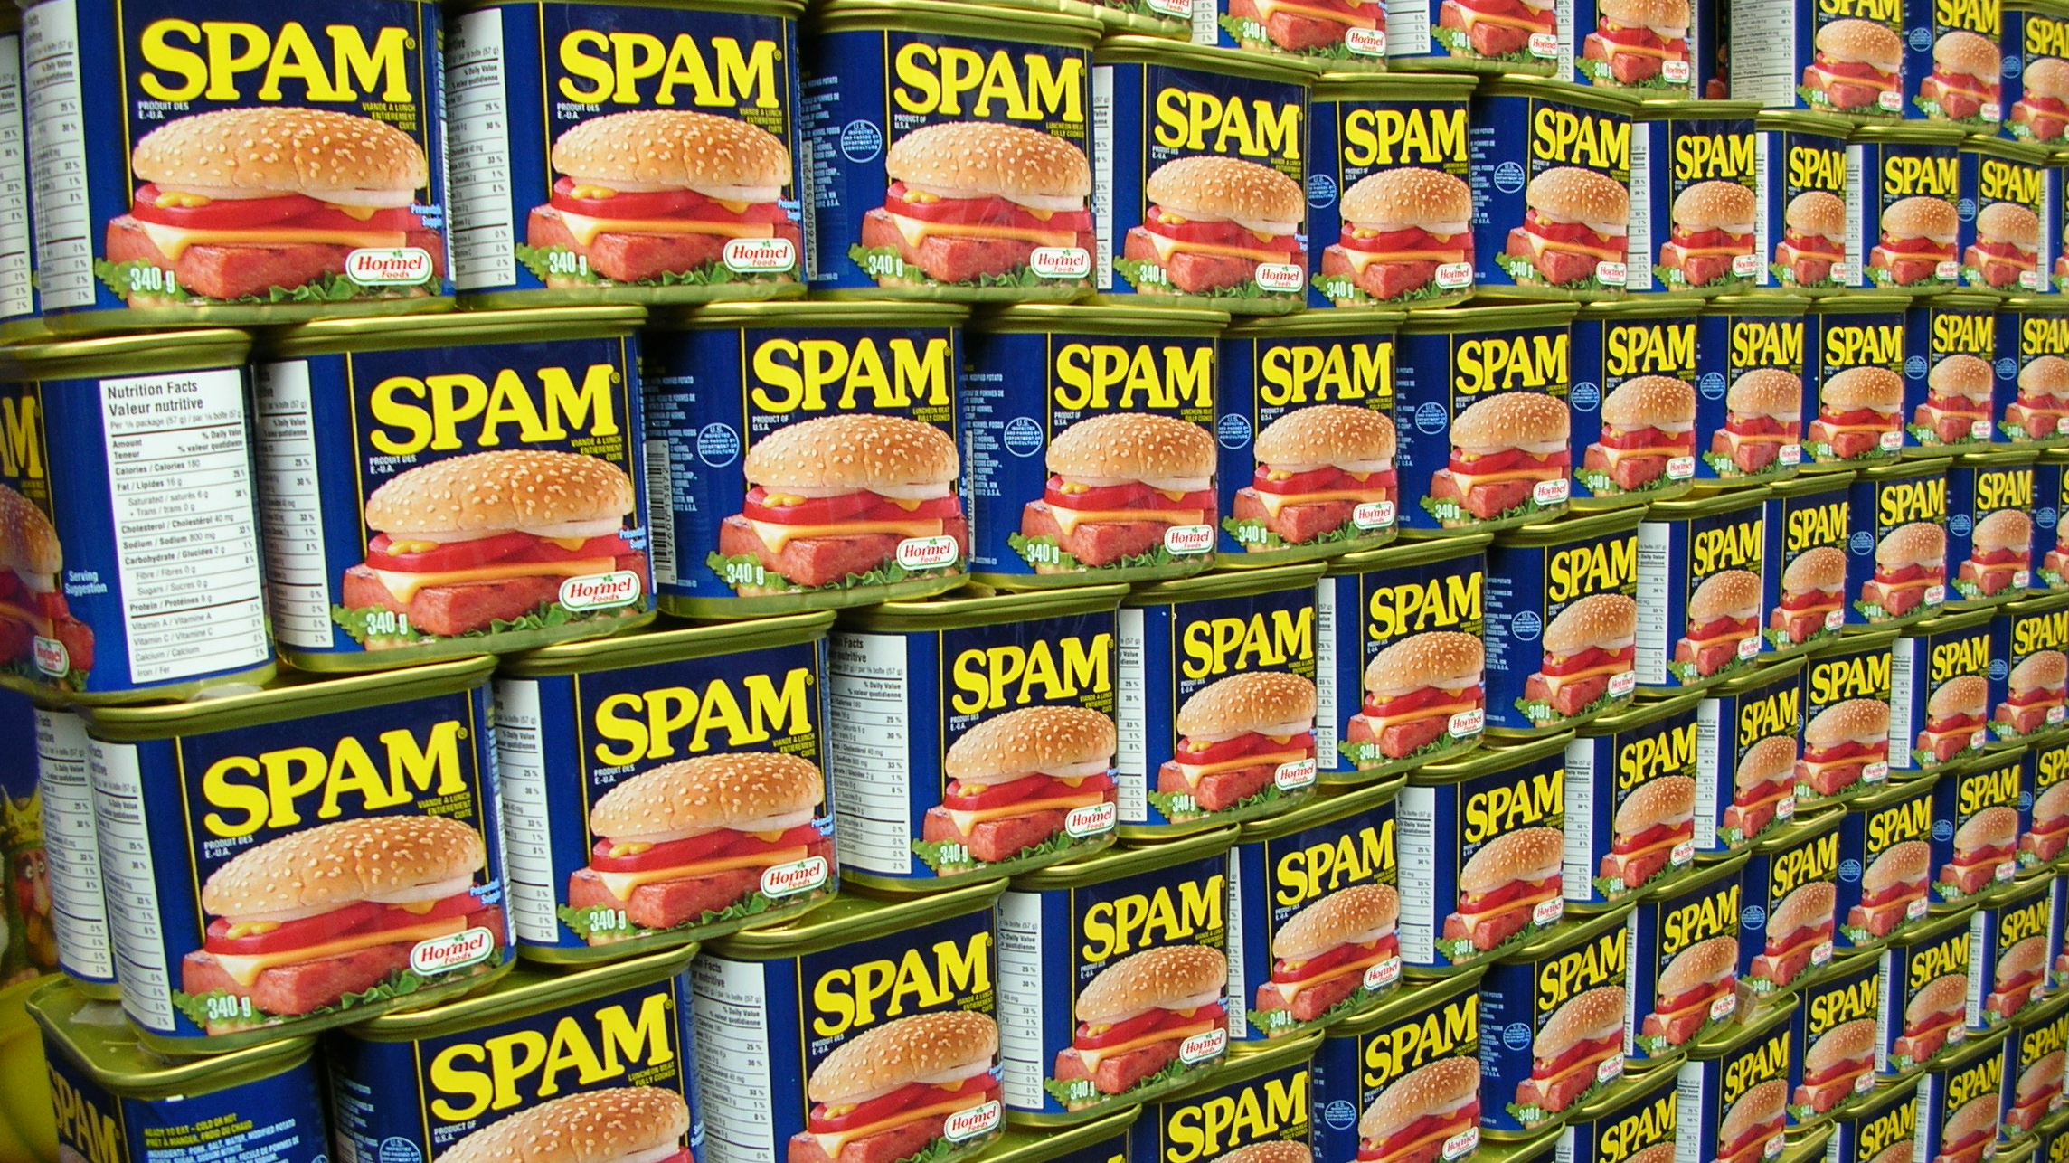
IRRELEVANT. UNTIMELY.
Notes:
We all hate SPAM. SPAM is irrelevant. SPAM is untimely.
Although we associate it with Viagra pills and fraud, SPAM is irrelevant messages sent to a large number of recipients.
This is what brands do on a regular basis.

Slide 4
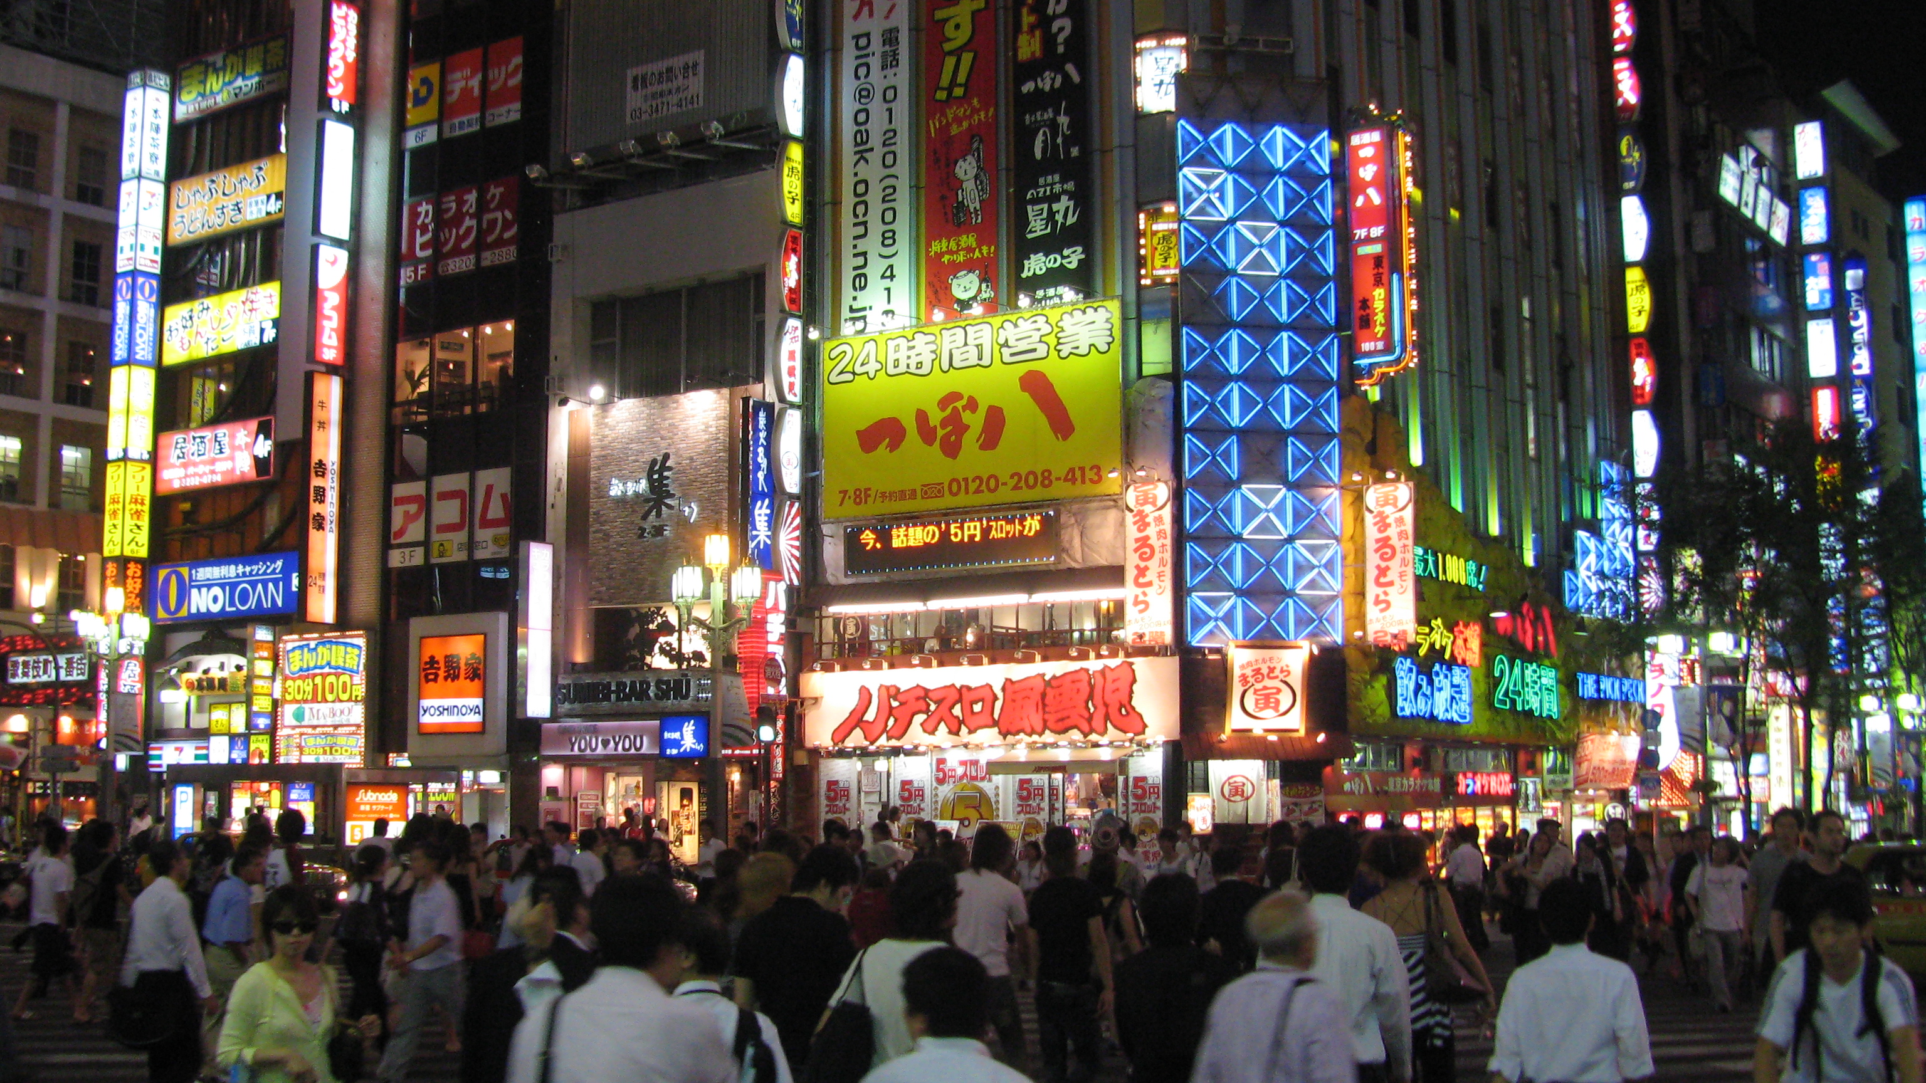
MASS MARKETING.
MASS MARKETING.
Notes:
Brands communicate with us on a mass scale level that lacks personalization.
We are treated all the same. A list based on a single touch point. A single attribute tied to who we are.
People are much more complex than that.

Slide 5
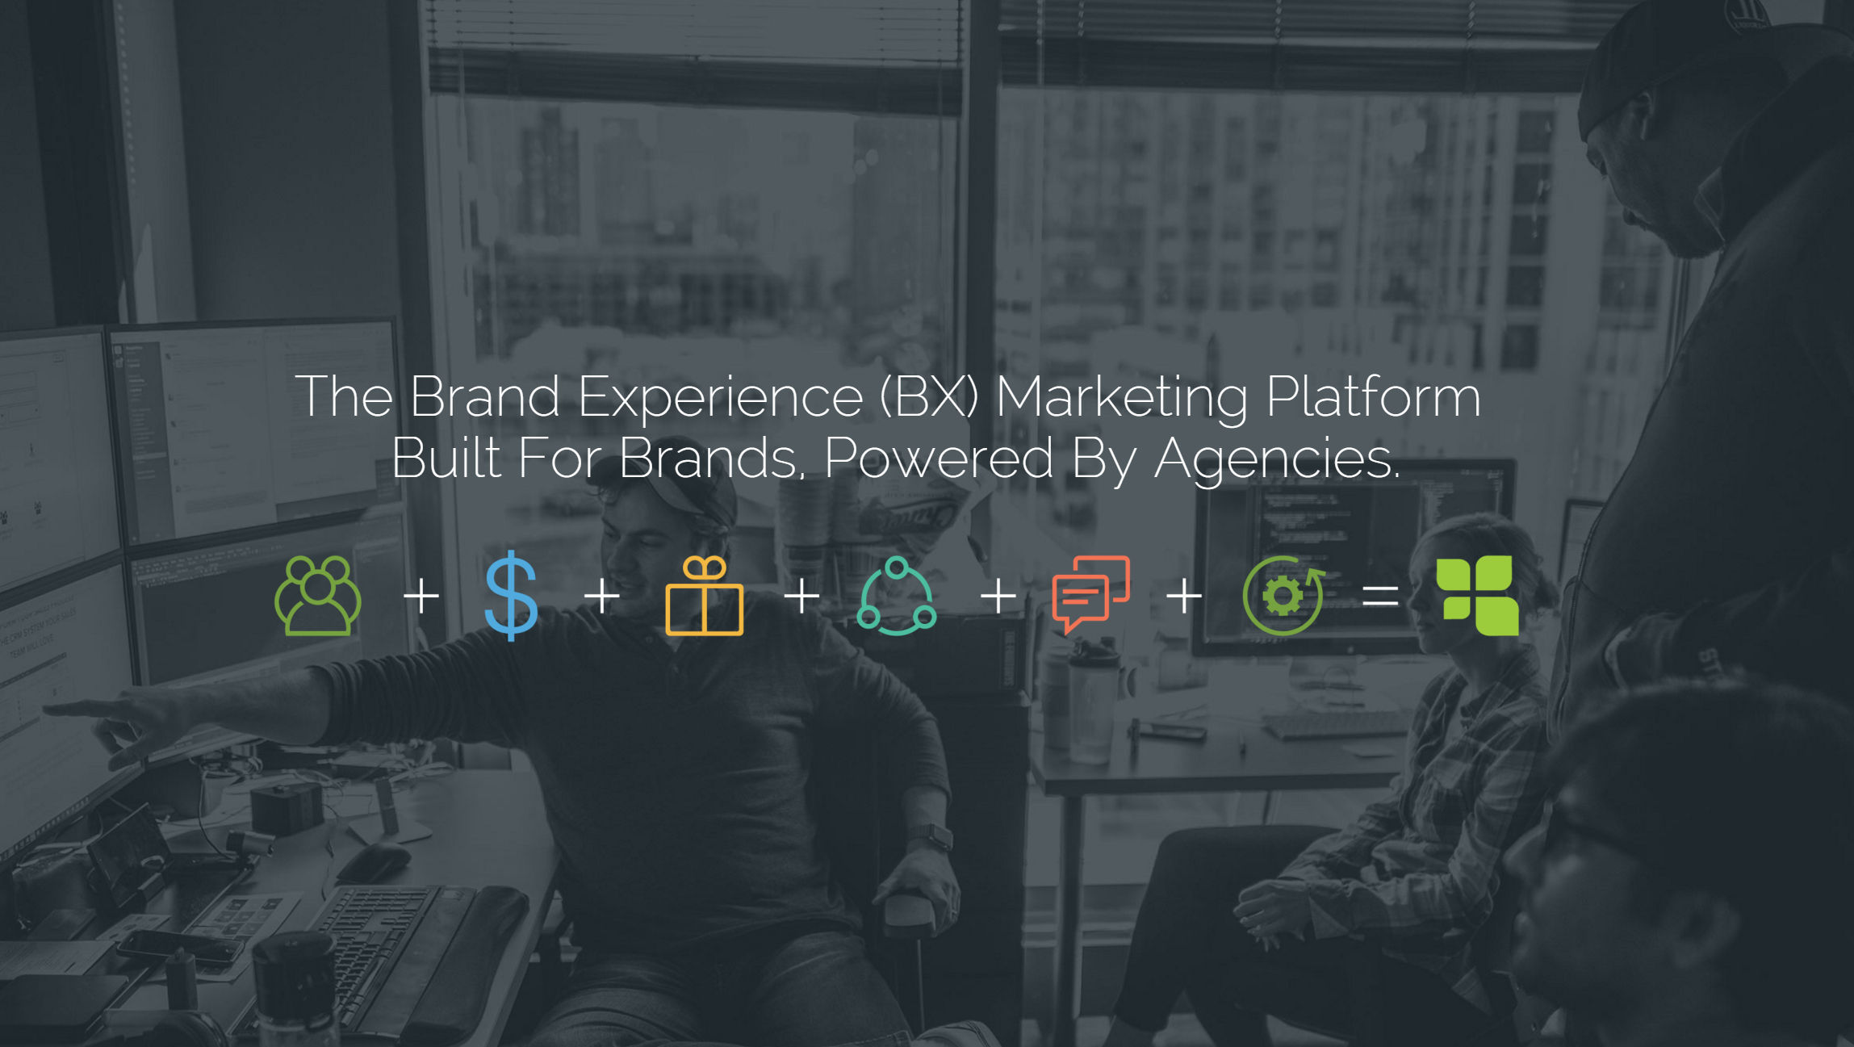
Notes:
It doesn’t need to be that way.
PeopleVine helps companies create brand affinity with their consumers through personalization on a mass scale.
We are the Brand Experience Marketing Platform. Built for Brands, Powered by Agencies.

Slide 6
DATA
MARKETING
Notes:
PeopleVine is made up of two core competencies:
Data Capture
We provide the tools to create consumer engagement to learn through every experience.
Whether it’s your web site, social, ecommerce, events, loyalty ... What ever it may be…
PeopleVine provides the tools to capture this data through our turn key experiences or our API.
Segmented Marketing
As we capture this data, PeopleVine begins to store and sort these relevant touchpoints to a single profile.
So as a marketer, you can now create targeted marketing opportunities to keep people engaged with your brand.
And by leveraging the data captured, you can begin to filter and segment your audience to place them in automated campaigns.

Slide 7
Notes:
By leveraging these various touchpoints, captured through the PeopleVine Platform, you begin to understand who your consumers are and how they interact across a multitude of channels... online, social, in store, at home, etc. All the data captured is tied to a single CRM profile for this person.

Slide 8
AVOID A
SEGMENT YOUR
SINGLE FUNNEL
AUDIENCE
Notes:
So unlike your traditional Inbound Marketing Platform, where your customers come through a single funnel due to a limited amount of interactions.
PeopleVine, leveraging its consumer engagement suite of tools, allows you to segment your customers based on a series of touch points. Ensuring they receive relevant and timely information.

Slide 9
RELEVANT & TIMELY
MARKETING!
Notes:
Bringing it full circle, PeopleVine provides you the platform to build experiences to capture data.
It helps you leverage this data to send relevant and timely marketing opportunities.
It does this on a mass scale.
So now, brands can now communicate with us on a mass scale level with personalization through PeopleVine.

Slide 10
Notes:
We are working with some top agencies and marketers globally to put PeopleVine into the hands of amazing companies.
Through our partners, we have launched nearly 100 campaigns/web sites on PeopleVine. Helping these brands connect with their consumers and automate their marketing.
We look forward to your company being next.

Slide 11
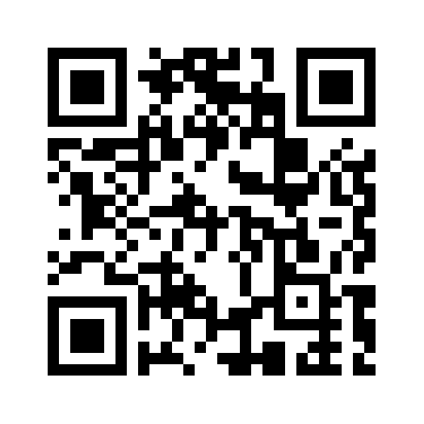
We got your backend
1165 N Clark Street, Suite 700
Chicago, IL 60610
info@peoplevine.com
www.peoplevine.com
(312) 957-7737
text PeopleVine to (312) 957-7737
Notes:
We hope that you see how PeopleVine brings relevance to marketing.
To learn more check out our web site at www.peoplevine.com and click on Join a Demo to see it in action.
Thank you for your time.

