Slide 1


PACKAGING INNOVATIONS SUMMIT
January 28, 2015

Slide 2

WHO WE ARE
THE ALLIANCE ECOSYSTEM
We pride ourselves on the ability to combine our creative expertise with a robust network of shared resources to create innovative new packaging solutions, enhance corporate identity campaigns, and engage consumers on every level.
ACG is comprised of 5 Business groups covering design, print, packaging, distribution, supply chain management and consumer engagement
Core business has been servicing clients for over 17 Years
7 Warehouses located strategically across the U.S.
8th warehouse opening this spring (Indianapolis, IN)

Slide 3
WHAT WE DO
Packaging : Flexible (Special Lamination, Laser & Macro Perforation) Folding Cartons, Corrugate (Litho-Lam, Die Cut, Specialty Glue), Thermoforming
Printing : Commercial Sheet-fed, Web, Large Format, Digital and Promotional
POP / POS Displays / Club Packs / Pallet Displays
Supply Chain Management : Inventory, Distribution and Logistics (JIT)
Creative & Design
Consumer Engagement
Direct Mail and Response
Fulfillment & Assembly
Corporate Identity Development
Business Consulting & Strategic Marketing

Slide 4
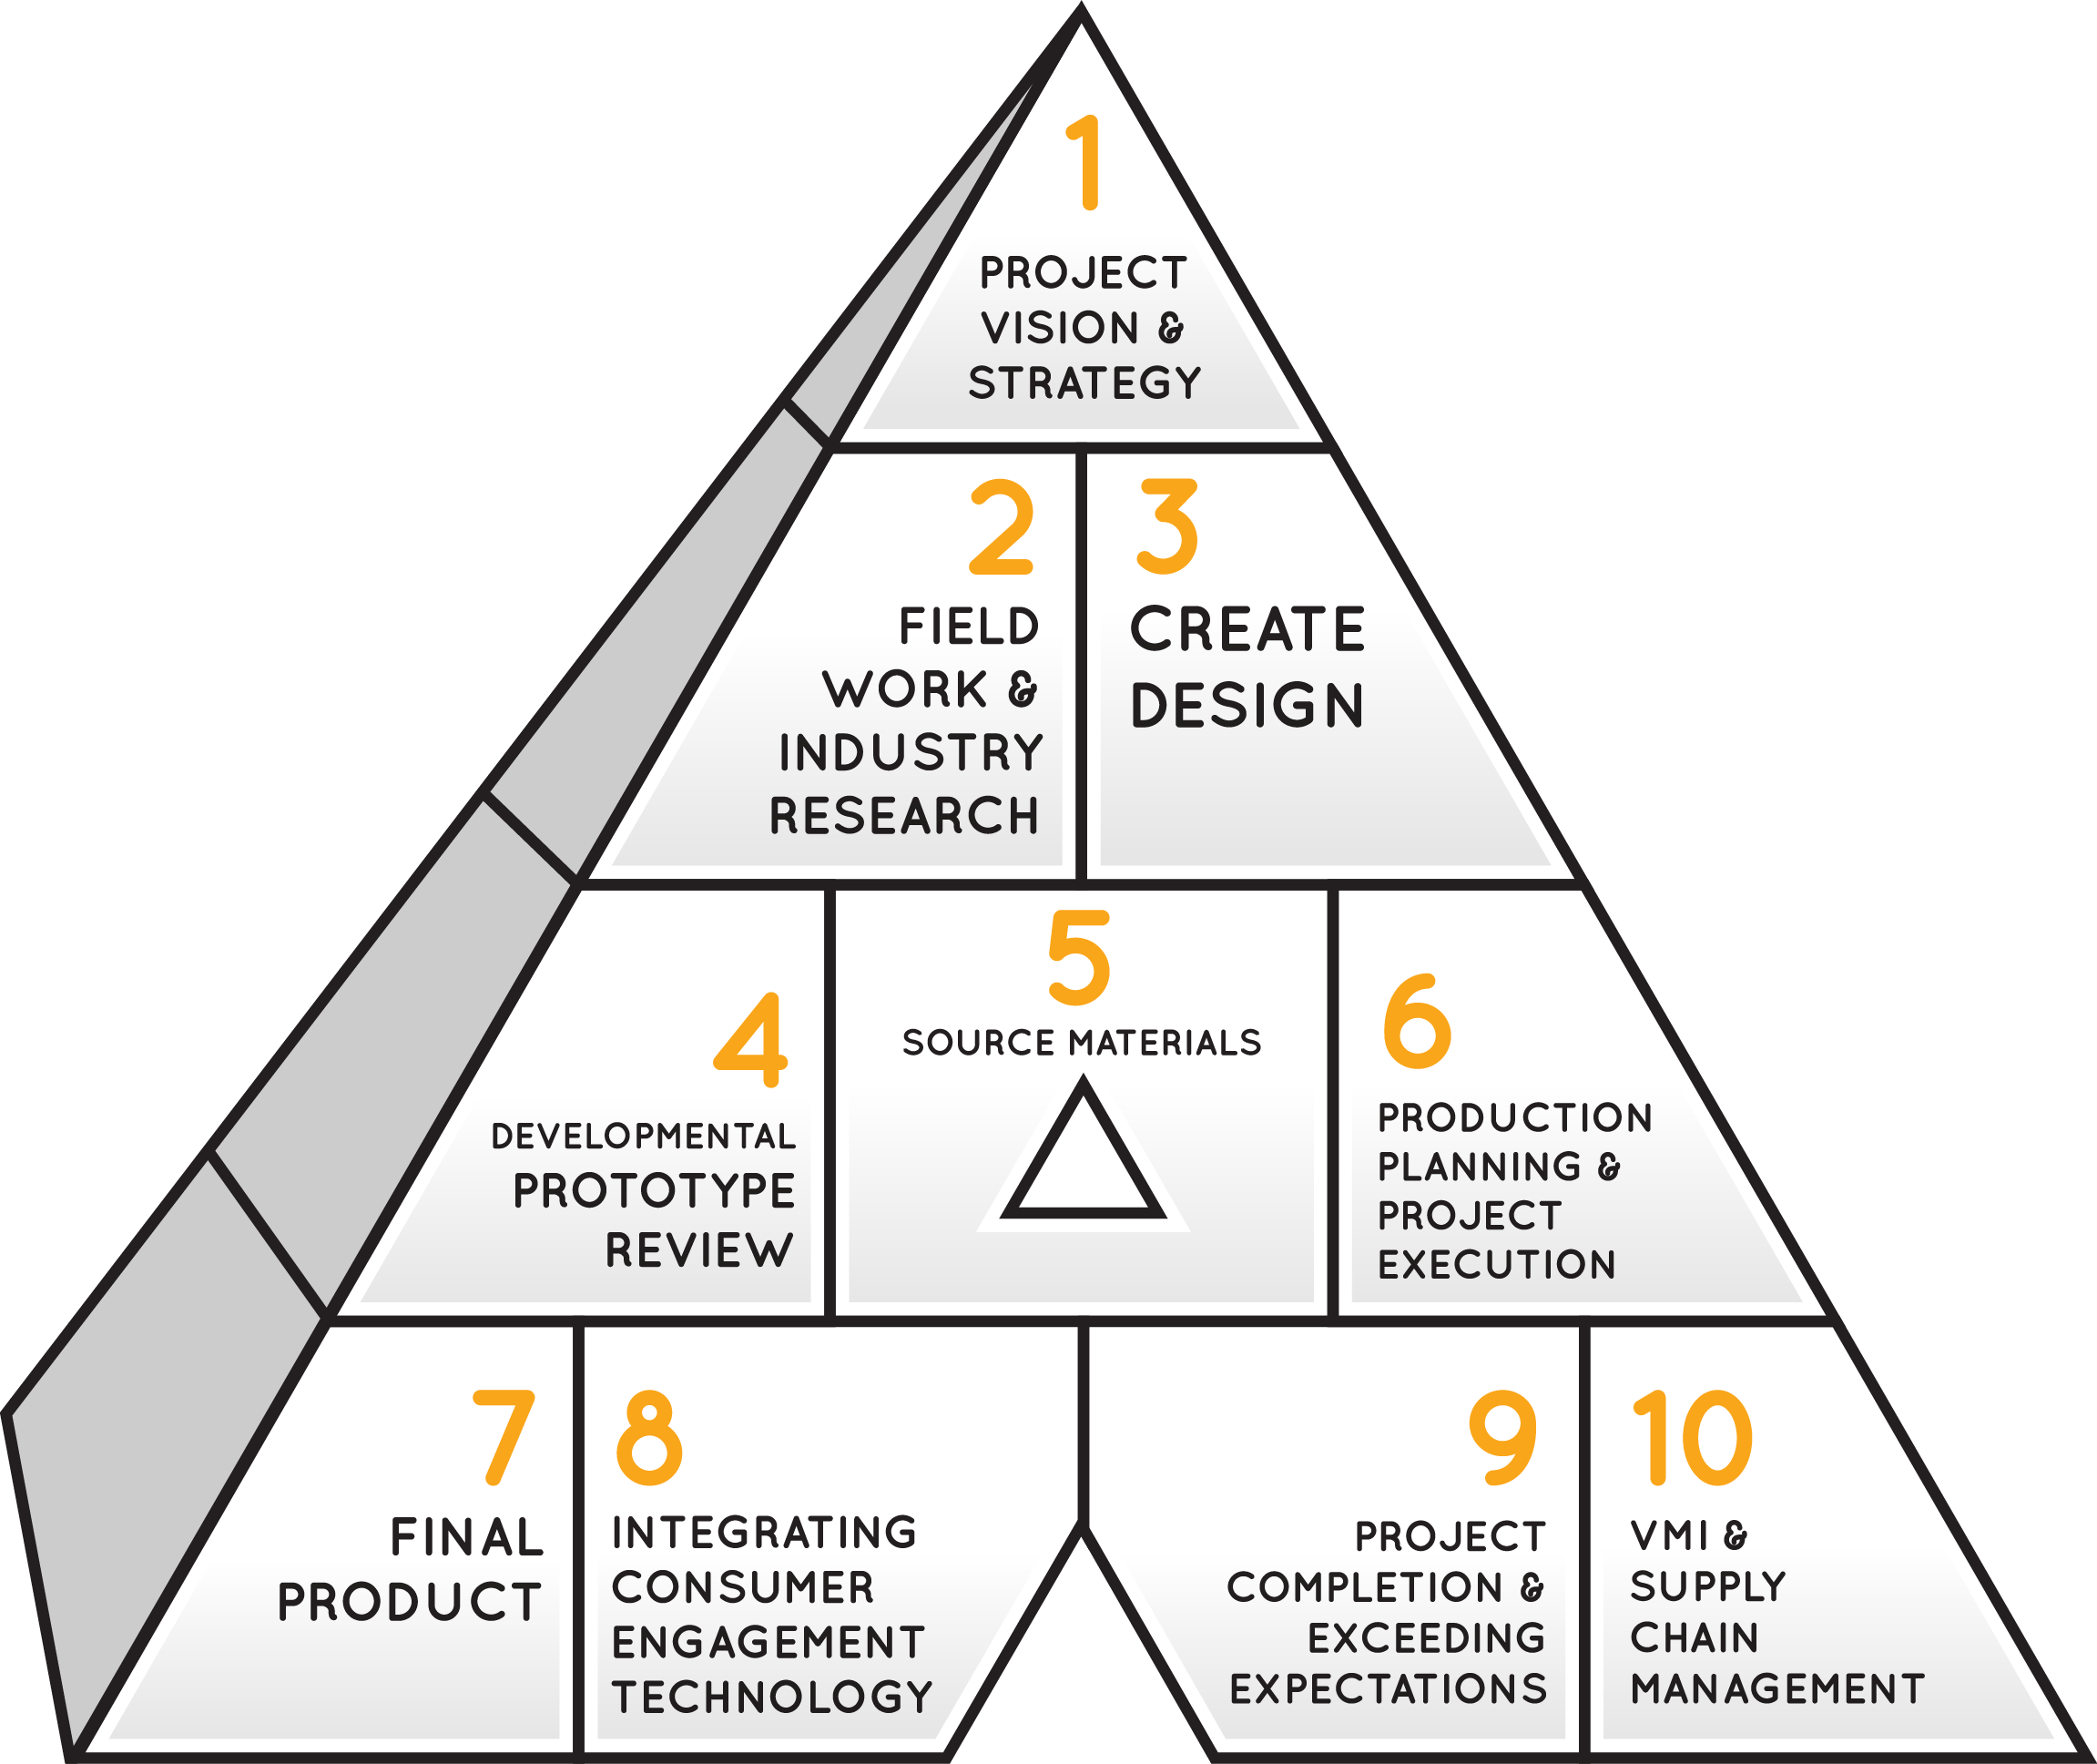
HOW WE DO IT
THE ACG PROCESS
Project Vision & Strategy
Field Work & Industry Research
Create Design
Developmental Prototype Review
Source Materials
Production Planning & Project Execution
Final Product
Integrating Consumer Engagement Technology
Project Completion & Exceeding Expectations
VMI Supply Chain Management

Slide 5

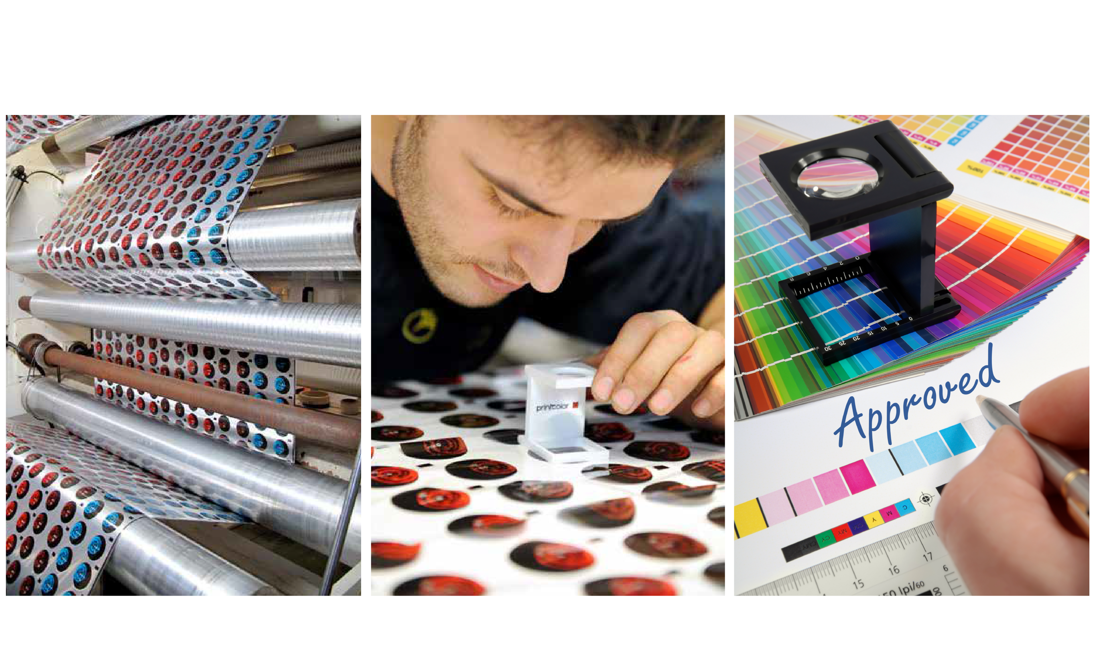
A PRODUCT COMMUNICATES THROUGH PACKAGING.
Our priority has always been to design, develop and produce made-to-measure solutions to meet the unique and specific needs of each of our clients. Through research and collaboration ACG is the innovative solution for any customer.

Slide 6

SPECIAL LAMINATES
Film with paper/hard insert
INNOVATIVE
LOOK-INSIDE SOLUTION
The sole look-inside packaging with customized windows made at register and supplied in roll. Barrier to gases and flavors is guaranteed. Makes your packaging smart and noticeable on the shelf.

Slide 7
SPECIAL LAMINATES
Film with paper/hard insert
PAPER FILM
The shape and design of paper area alternating to plastic, metalized or aluminum film make the packaging traditional and innovative at the same time. The plastic film guarantees sealability and gas barrier.

Slide 8
SPECIAL LAMINATES
Film with paper/hard insert
NET BAG
This new and interesting solution for fruit and vegetable packaging makes your product more modern. The net is resistant to breakage and supplied in roll which can be used on your existing packaging machines with no need for adjustments.

Slide 9
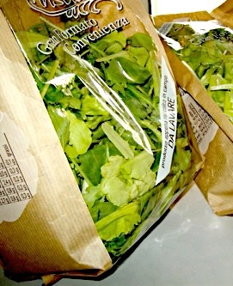
SPECIAL LAMINATES
Film with paper/hard insert
This solution allows a seamless marriage of paper and transparent film to create a custom design. These materials are obtained from natural sources such as corn.
Processing performance of PLA-paper laminates is similar to that of plastic films.

Slide 10

INNER VALVES
Innovative solution to preserve and cook
PHANTOM
The invisible unidirectional and no tactile valve makes this perfect for coffee beans and powders. The controlled release of gases prevents explosion or swelling of packs. Phantom is available both in rolls and pre-made bags.

Slide 11
INNER VALVES
Innovative solution to preserve and cook
MICROVAPOR
& VULCAN
Microvapor and Vulcan are steam vent valves applied at register on precise areas of packaging. They guarantee cooking in the microwave without any concern. These solutions are both supplied in rolls with thermic valve for Microvapor and mechanical for Vulcan.

Slide 12
INNER VALVES
Innovative solution to preserve and cook
MICROVAPOR
TECHNOLOGY

Slide 13
INNER VALVES
Innovative solution to preserve and cook
Play at
http://content.alliancecreativegroup.com/page/P192010373

Slide 14

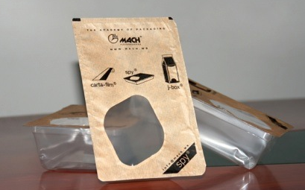
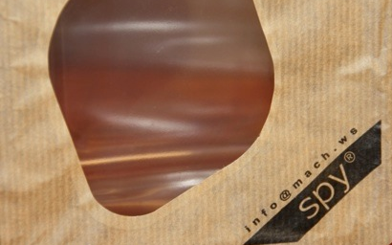
OPEN & CLOSE
Re-closable film for lids

Slide 15
OPEN & CLOSE
Re-closable film for lids
OPEN
100% recyclable PET can
be peeled off the tray.
The open & close solution for flow pack and lid films is available in roll stock. Rolls can be used straight on the packaging machine with no additional costs of adaptation for your equipment.

Slide 16
OPEN & CLOSE
Re-closable film for lids
RE-CLOSABLE
This particular kind of material allows you to
re-close the packaging with no need to apply adhesive labels. The shape can be customized creating a final product that is extremely practical and easy to handle.

Slide 17

OPEN & CLOSE
Re-closable film for lids
OPEN & CLOSE
TECHNOLOGY

Slide 18
OPEN & CLOSE
Re-closable film for lids
Play at
http://content.alliancecreativegroup.com/page/P192010374

Slide 19

LASER TREATED & PERFORATED
Mechanical or laser precise technological perforations
MACROPERFORATED FILM
Perforating the film with a mechanical system at register allows air circulation inside the package. Holes can be customized in shape and position depending on the content as well.

Slide 20
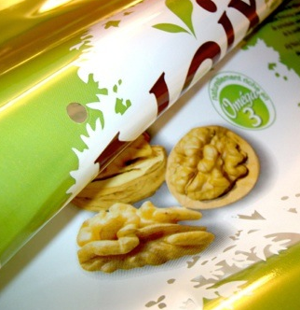
LASER TREATED & PERFORATED
Mechanical or laser precise technological perforations
This processing is a technique of mechanical perforation of plastic films. The perforation is operated precisely where requested.
Perforations’ size is between 3 and 6 mm and is adjusted on the basis of the content and its life cycle.

Slide 21
LASER TREATED & PERFORATED
Mechanical or laser precise technological perforations
OXY®
Oxy® laser perforation applied with a precise laser technique establishes a perfect equilibrium between oxygen and carbon dioxide. It’s the perfect answer to allow fresh vegetables to remain fresh longer.

Slide 22

LASER TREATED & PERFORATED
Mechanical or laser precise technological perforations
OXY® FILM TECHNOLOGY

Slide 23
LASER TREATED & PERFORATED
Mechanical or laser precise technological perforations
Play at
http://content.alliancecreativegroup.com/page/P192010375

Slide 24
LASER TREATED & PERFORATED
Mechanical or laser precise technological perforations
ZIPPERLESS CLOSURE TECHNOLOGY

Slide 25
LASER TREATED & PERFORATED
Mechanical or laser precise technological perforations
Play at
http://content.alliancecreativegroup.com/page/P192010376

Slide 26

ECO FRIENDLY
Sustainable solution
PLA PAPER
An eco-friendly solution which is entirely compostable. PLA film laminated with paper stripes creates a great visual impact. Consistency and machinability are the same as a standard laminated film.

Slide 27
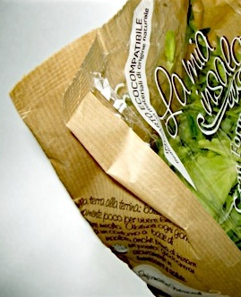
ECO FRIENDLY
Sustainable solution
We have the ability to marry PAPER + BOPP where the consumer can easily separate the PAPER from the BOPP and recycle separately.

Slide 28

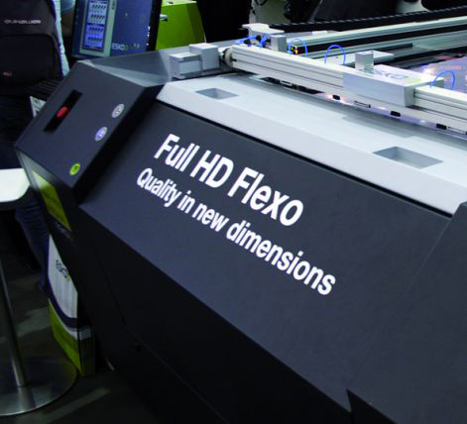
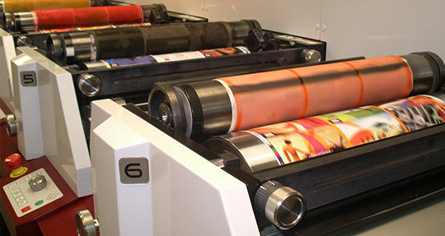
DIGITAL PRINTING
We are capable of full HD flexographic printing as well as rotogravure printing.
This technology allow us:
To achieve an excellent quality level, thanks to the evolution of digital flexographic (full HD)
To achieve flexibility in timing and speed of implementation
To satisfy the graphic needs for a market more and more demanding

Slide 29


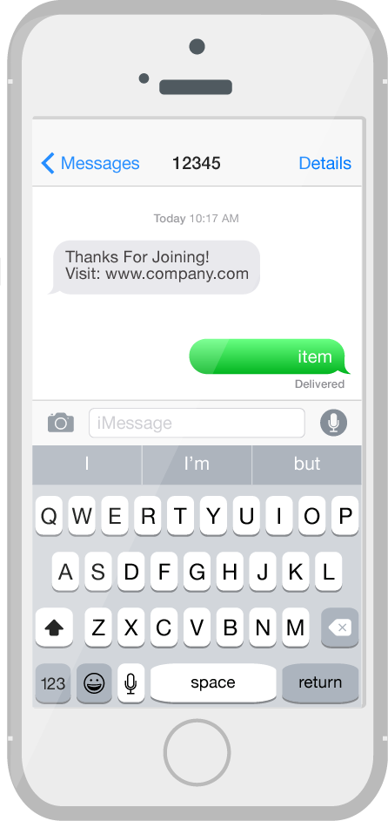
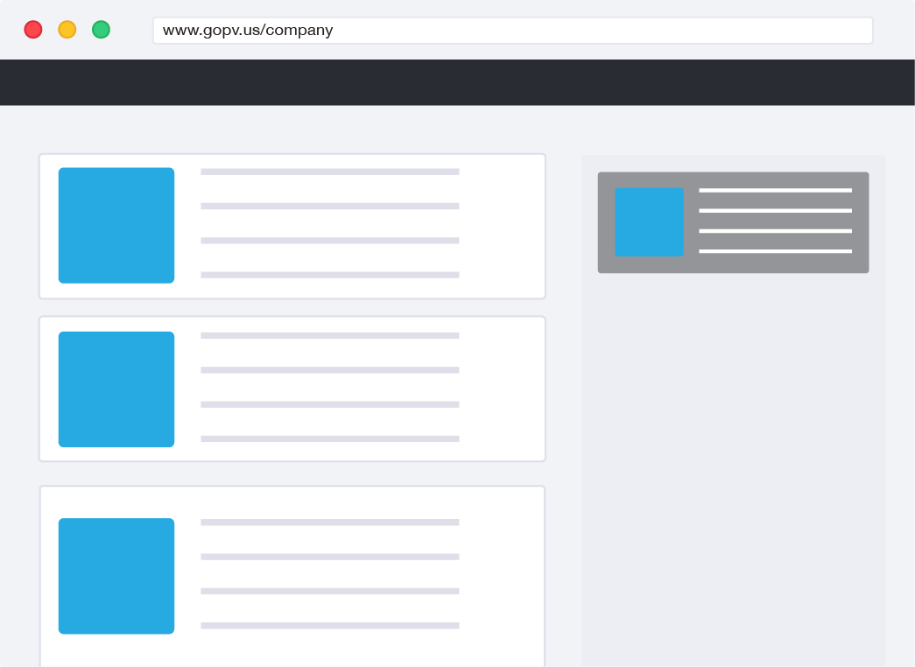

ENGAGE YOUR CONSUMERS
Our consumer engagement platform bridges the offline world into an online engaging experience for your consumers to build brand loyalty.
SCAN
QR Code
TEXT
“item”
to 12345
TWEET
“#item”
to @company
VISIT
http://gopv.us/company
Whether in store or at home,
our platform works across every device.

Slide 30
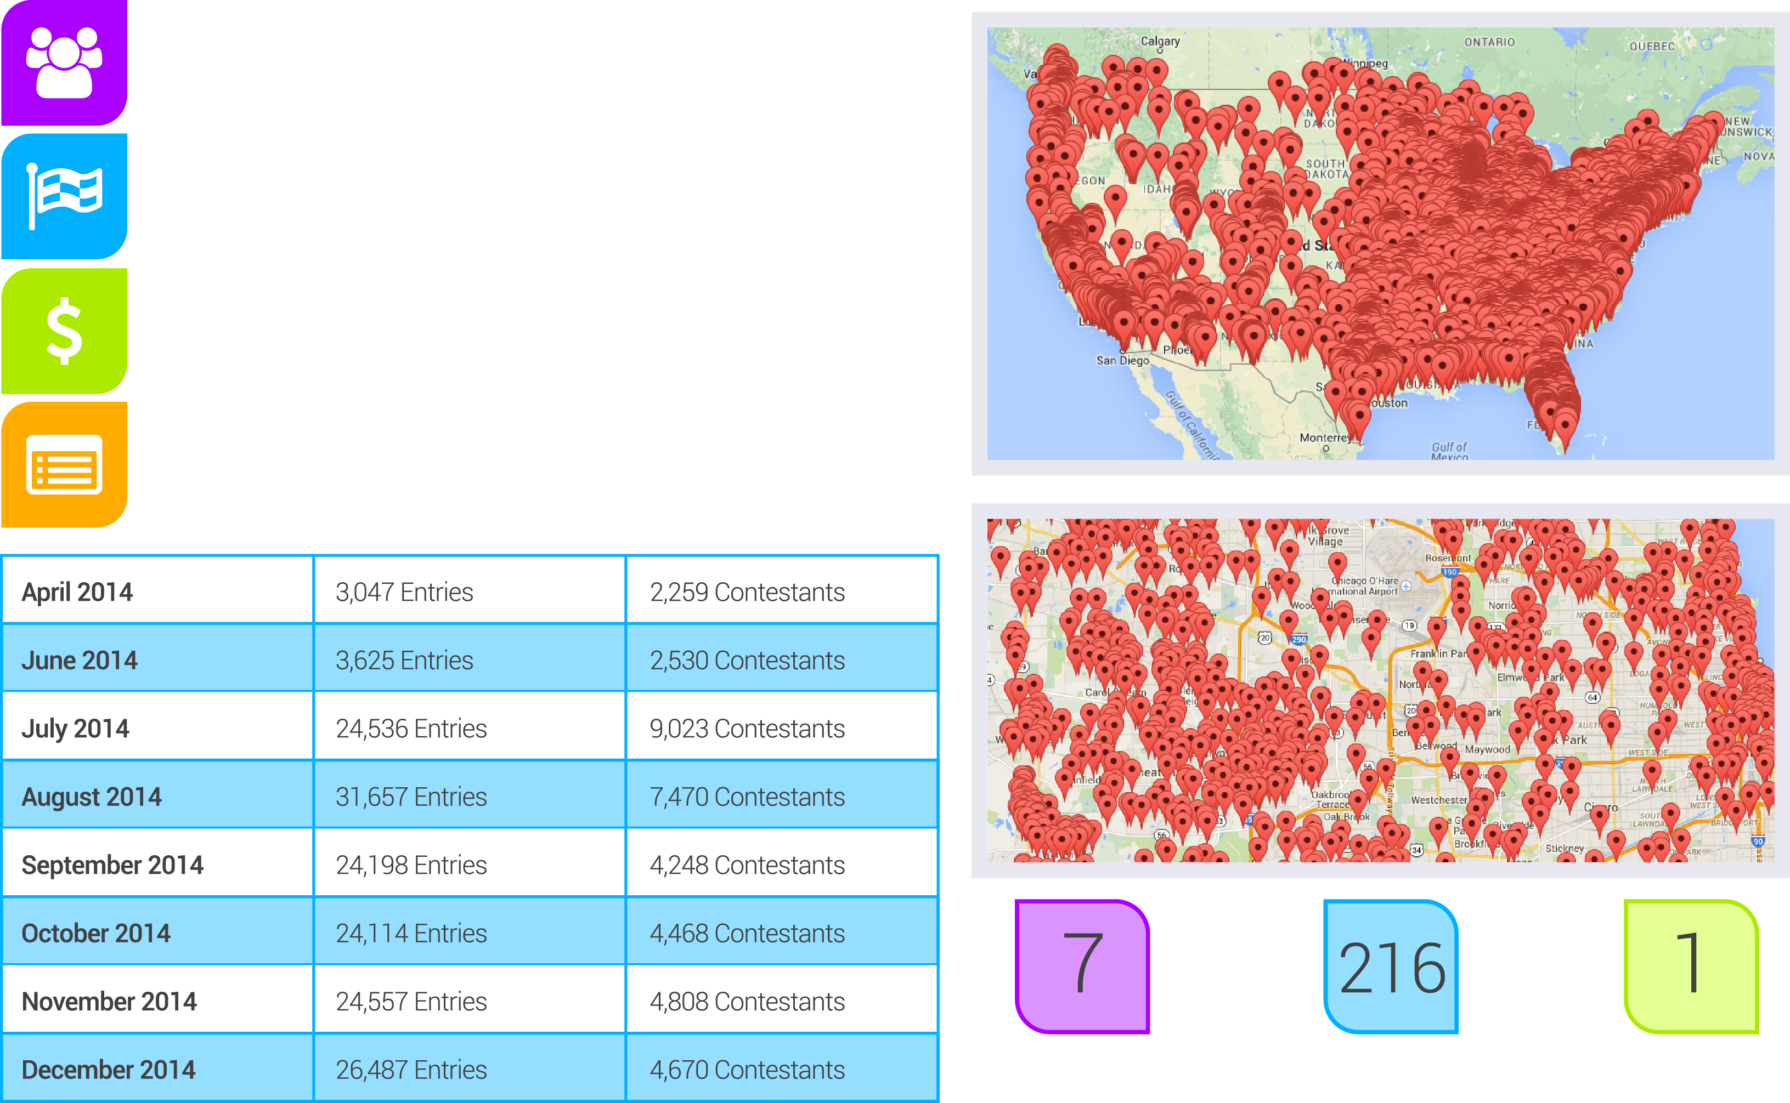
REAL-TIME RESULTS

Slide 31






CLIENTS

Slide 32




CLIENTS

Slide 33

WHY ACG?
One Contact
Proven Results
Multiple Supply Chain Managed Services
Proprietary Consumer Engagement Technology
Unique Abilities
Exceptional Customer Service
Competitive Pricing
Brand Building
Responsiveness
National Distribution Facilities

Slide 34

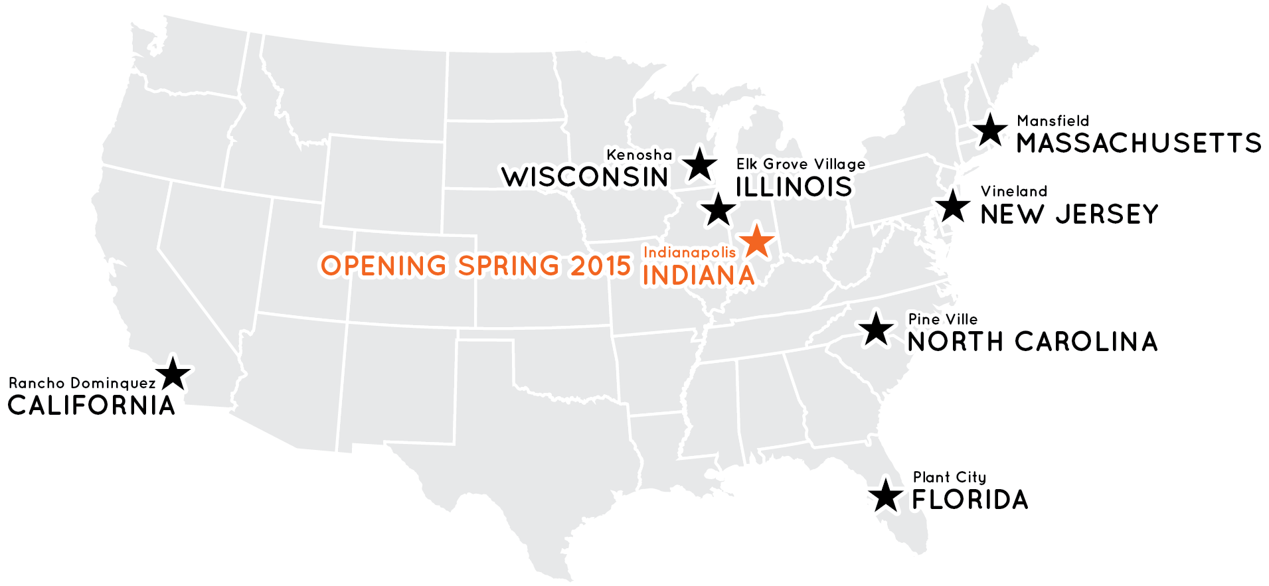
ONE SIMPLIFIED
PROCUREMENT PROCESS
Quality Motivated
Response Team
Specialized Production
& Procurement Network
National Distribution Facilities
Innovative Consumer Engagement Technology Across Every Device
ALLIANCE CREATIVE GROUP, INC.
Corporate HQ • Schaumburg, IL 60173

Slide 35
Steve St. Louis – CEO
Vern Meyer – VP of Business Development
ALLIANCE CREATIVE GROUP, INC.
1066 National Parkway • Schaumburg, IL 60173
Phone: 847-885-1800 x133
www.AllianceCreativeGroup.com
Email: Steve@ACGemail.com

